Slide 1
GRADUATE ADMISSIONS
Project By
M. MADHU KIRAN VARMA - 15PA1A05A3

Slide 2
PREDICTION OF GRADUATE ADMISSIONS USING ADVANCED REGRESSION TECHNIQUES
Our project ‘GRADUATE ADMISSIONS’ is a standard Machine Learning approach for predicting the chance of admission for an individual aspiring for a Masters Degree specifically in the United States.
The people who are aspiring for a Masters Degree will make sure that they are applying for a good university with limitless opportunities for both professional and career orientation.
This project aims at providing the individual's an insight of their admission chances by taking in the data of their GRE, TOEFL, CGPA scores and the recommendations like LOR and SOP eventually drawing inferences by providing a rating out of 1(for higher chances) and 0 (for critical chances).

Slide 3
PANORAMA OF THE PROJECT
The entire project can be categorized into the following tasks :-
Data Acquisition
Data Exploration
Data Visualization
Data PreProcessing
Data Modeling
Algorithm Implementation
Algorithm Optimization

Slide 4

DATA ACQUISITION
Data Acquisition is one of the key steps in Machine Learning.Since, it is more prerogative to understand the data or just to feed the data as an input to the specific Machine Learning Model is achievable only in a 'Tabular Sense' i.e., if the input dataset is converted to a tabular data, then it is more flexible for the model to build accurate predictions out of the perfected data format.

Slide 5

Data Exploration is a crucial step in the process of Machine Learning.It helps us to understand the patterns and available features in a data set from which we can determine the sort of actions that we can perform for further analysis.
Data Exploration gives an intuition that a cursory investigation of the data-set is necessary for familiarizing Yourself with the data through an explorative process and is a fundamental practice to help you better understand and justify your results.
Since, the main goal of this project is construct a working model that has the capability of predicting the 'ChanceOfAdmit' scores, we will need to separate the dataset into features and the target variable.
DATA EXPLORATION

Slide 6

DATA VISUALIZATION
Exploratory Visualization can be defined as an approach for analyzing data sets to summarize their important characteristics, often by the application of visual methods.
The Primary theme of Exploratory Visualization is for observing what the data can give us an intuition far beyond the conventional modeling or hypothesis testing tasks.
In this part of the project, we will be plotting scatterplots for establishing the correlations between the input features ‘GRE SCORE’, ‘TOEFL SCORE’, ‘LOR’, ’SOP’, ‘RESEARCH’ etc. and the target variable ‘Chance of Admit’.

Slide 7

DATA PREPROCESSING
Data Preprocessing is one of the key procedures in Machine Learning that involves transforming the raw input data into an understandable format.
This step is quite crucial because the Real-World data is often incomplete and inconsistent, or lacking in certain behaviours or trends, and is most probably consists of many errors.
In the current problem an irrelevant feature is present that is 'Serial No',which actually plays no role in the determination of the 'Chance Of Admit' rate.Hence, it is quite valid to remove it from the dataset.

Slide 8
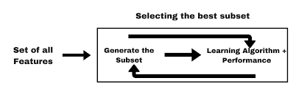
FEATURE SELECTION IN DATA PREPROCESSING
Feature Selection is an important concept in the Data Preprocessing phase which involves the removal of irrelevant attributes and retaining only those features that have show better performance.
I implemented Feature Selection using a Linear Regressor, the benchmark model that i used to prune the features that actually have a lower rank of performance.
Recursive Feature Elimination(RFE) uses a model (here Linear Regressor) to select either the best or worst performing feature, and then simples prunes the feature. After this the entire process is iterated until all the features in the data set are used up(limit).

Slide 9
DATA MODELING
By observing the problem, it is quite evident that it is a 'Regression' Problem. It is important to understand the intuition behind the consideration of specific model, since it has to generate an optimal possibility of results that can improve the model's performance on a sample of new data. Hence, taking the performance of the model into consideration, I chose three Supervised Machine Learning Algorithms that can be better compatible for the data being available.
They are :-
Decision Trees
Ensemble Methods - Random Forests
Support Vector Machines (SVM)

Slide 10
DECISION TREES
Decision Trees are very flexible,easy to understand and easy to debug.They usually work on Classification and Regression Problems i.e.,for categorical problems having [green,red,blue..etc.] and continuous inputs like [2.9,3.8..etc].They usually cover both the perspectives.
It divides the dataset into smaller and smaller subsets while at the same time an associated decision tree is incrementally developed. The final result is a tree with decision nodes and leaf nodes. A decision node has two or more branches, each representing values for the attribute tested. Leaf node represents a decision on the numerical target. The topmost decision node in a tree which corresponds to the best predictor called root node. Decision trees can handle both categorical and numerical data.

Slide 11
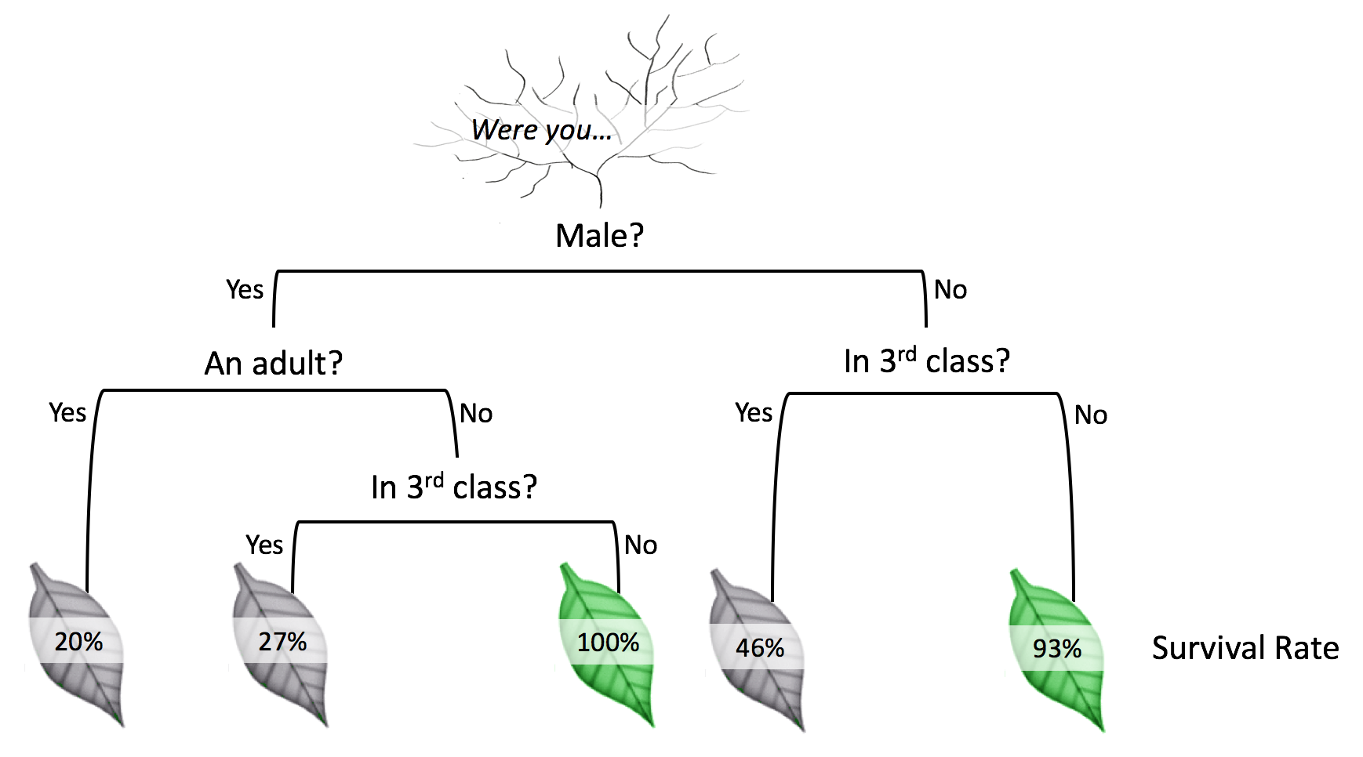
Typical Decision Tree Notation

Slide 12
RANDOM FORESTS
Random forests are an ensemble learning method for classification, regression and other tasks, that operate by constructing a multitude of decision trees at training time and outputting the class that is the mode of the classes in case of the classification tasks or mean prediction for the regression tasks of the individual trees.
The Random forests have a stroke of brilliance when a performance optimization happens to enhance precision of the model, or vice versa.Tuning down the fraction of features that is considered at any given node can let you easily work on datasets with thousands of features.

Slide 13
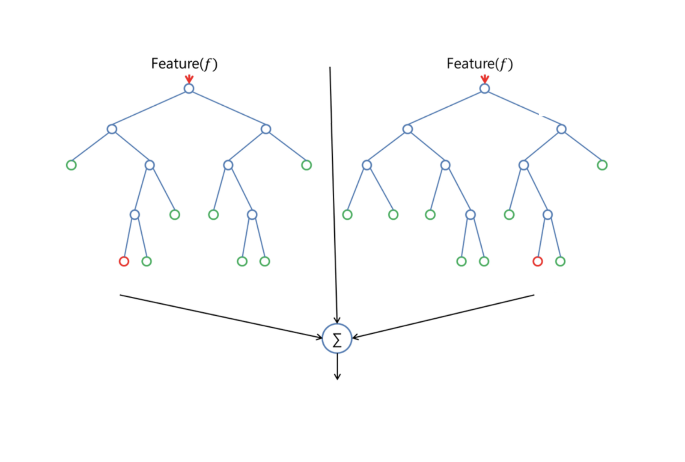
RANDOM FOREST ANALOGY

Slide 14
SUPPORT VECTOR MACHINES
SVM's are simple,accurate and perform well on smaller and cleaner datasets.It can be more efficient as it uses subset of training points.
The Support Vector Regression (SVR) uses the same principles as the SVM for classification, with only a few minor differences. Initially as the output is a real number and continuous it becomes very difficult to predict the information at hand, which has infinite possibilities.
In the case of regression, the factor margin of tolerance (epsilon) is set in approximation to the SVM.
The main theme for SVM is always to minimize error, particularize the hyperplane which maximizes the margin, keeping in mind that part of the error is convinced.
Since For the current regression problem consists of a lot of continuous features the application of SVM's can serve a better purpose.

Slide 15
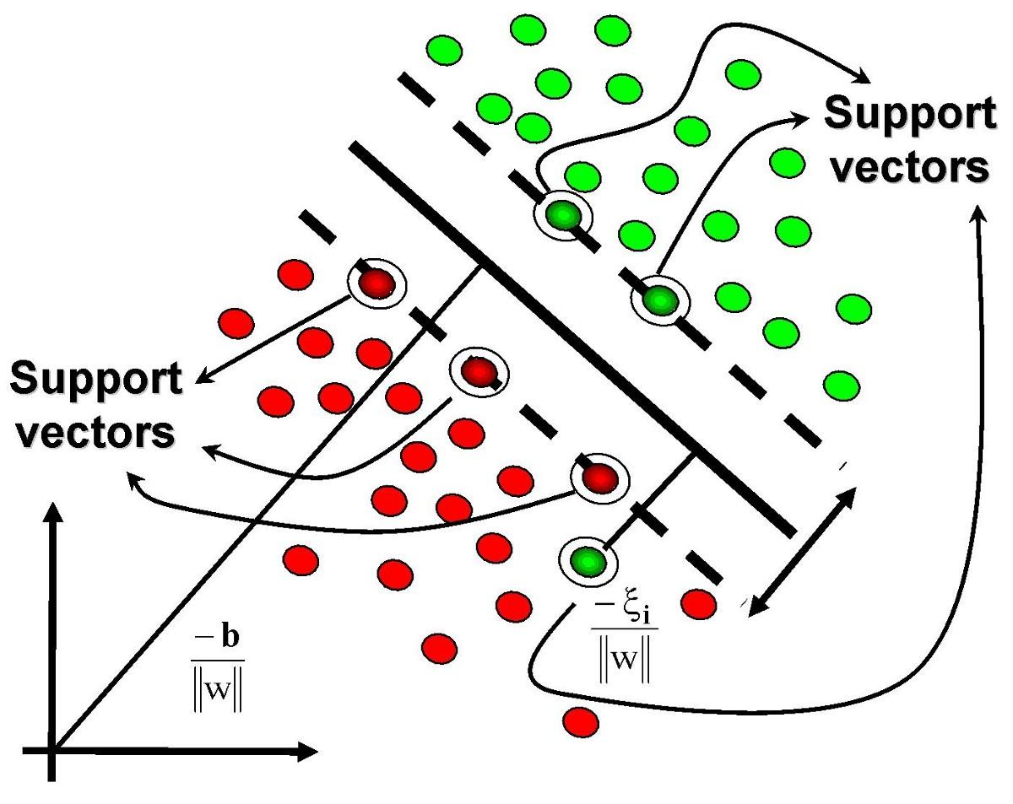
SUPPORT VECTOR MACHINES

Slide 16
ALGORITHM IMPLEMENTATION
In the further section of the project, I'll intuitively select the best out of the three models that I considered for the current problem by using the performance metric(r2_score), based on the results generated, I'll decide best of the three models, which is optimal for the given problem.
INITIAL MODEL EVALUATION
In this section, I'll clearly show the coding implementation of the three supervised learning models
Import the necessary libraries and initialize the models and store them in respective variables.
And finally comparing the r2_scores of the three learning models and decide which one is the best.

Slide 17
CHOOSING THE BEST MODEL
Since, it is obvious that the model which has best high r2_score when compared to the other models can be termed as the best optimal model for the current problem, as the fact that if :-
r2_score is 0 -> it indicates that the model is a worst fit to the given data.
r2_score is 1 -> it indicates that the model is the best fit to the given data.
r2_score in between 0 and 1 -> indicates that the respective variability exhibited by the target variable.

Slide 18
PERFORMANCE METRIC
The current problem is a Regression task, since it takes certain features as inputs and attempts to find a score that helps an individual to get an idea about the chances of getting an admission in a specific university.
Hence, Coefficient Of Determination is considered as the performance metric that can be applied to compare the performances of the scores obtained from the BenchMark and the Optimal Model considered.
The CoEfficient Of Determination(R^2) is the key output of the Regression Analysis.It can be defined as the proportion of the variance in the dependent variable that is predictable from the independent variable.

